Slide 1
Optimising query plans

Slide 2
Overview of this video
SQL query
Parse query & preprocess
Logical query plan (relational algebra)
Optimise logical query plan
This video
Optimised logical query plan
Select physical query plan
Physical query plan
Query Execution

Slide 3
How to optimise the initial query plan?

Slide 4




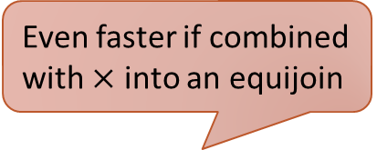

Why Optimise Query Plans?
The initial query plan might not be the optimal one
SELECT * FROM Stores, Employees WHERE worksAt=depart AND city=Liv;
Even faster if combined with $×$ into an equijoin
$σ$_{worksAt=depart}
Computed only for tuples with city=Liv
$σ$_{worksAt=depart AND city=Liv}
$$×$$
Inefficient if Stores contains few tuples with city=Liv
$$×$$
$σ$_{city=Liv}
Employees
Could exploit index
Stores
Employees
Stores

Slide 5


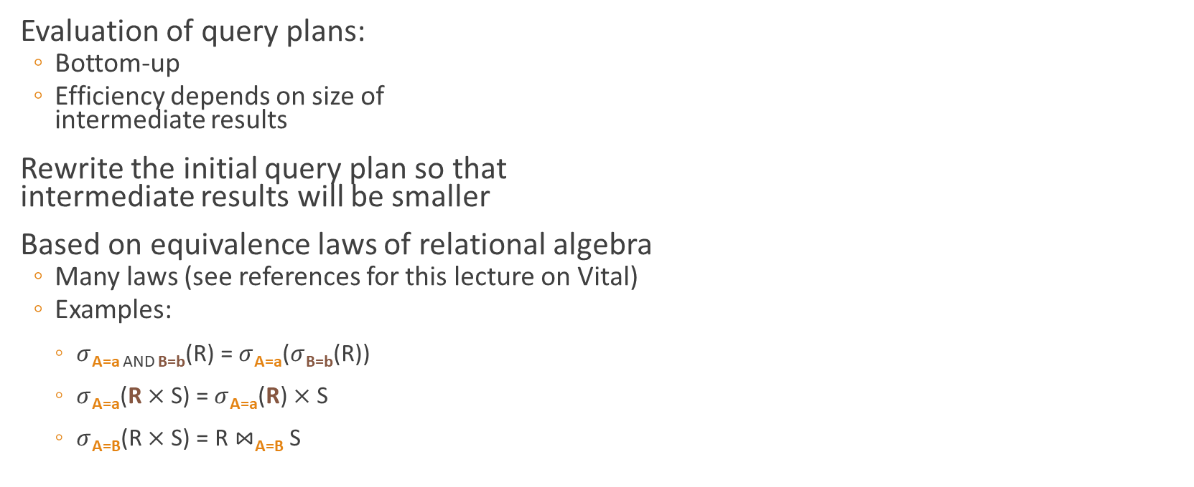
How to Optimise?
$σ$_{worksAt=depart AND city=Liv}
Evaluation of query plans:
Bottom-up
Efficiency depends on size of intermediate results
Rewrite the initial query plan so that intermediate results will be smaller
Based on equivalence laws of relational algebra
Many laws (see references for this lecture on Vital)
Examples:
$σ$_{A=a AND B=b}(R) = $σ$_{A=a}($σ$_{B=b}(R))
$σ$_{A=a}(R $×$ S) = $σ$_{A=a}(R) $×$ S
$σ$_{A=B}(R $×$ S) = R $⋈$_{A=B} S
$$×$$
Stores
Employees
If A is on R
If A is on R and B is on S

Slide 6







Heuristics
#1: Push selections as far down the tree as possible
$π$_{depart,name}
$π$_{depart,name}
$σ$_{worksAt=depart AND city=Liv}
$σ$_{worksAt=depart}
$$×$$
$$×$$
Stores
Employees
$σ$_{city=Liv}
Employees
Intuition: This gets rid of many irrelevant tuples very early during execution.
Stores

Slide 7










Heuristics
#2: “Push” projections as far down the tree as possible, or insert projections where appropriate
$π$_{depart,name}
$π$_{depart,name}
$σ$_{worksAt=depart}
$σ$_{worksAt=depart}
$$×$$
$$×$$
$σ$_{city=Liv}
Employees
$π$_{worksAt}
$π$_{depart,name}
$σ$_{city=Liv}
Stores
Employees
Stores

Slide 8












Heuristics
Many more heuristics…
#3: If possible, introduce equijoins for $×$ followed by $σ$
$π$_{depart,name}
$π$_{depart,name}
$σ$_{worksAt=depart}
Faster than $×$ followed by $σ$
$⋈$_{worksAt=depart}
$$×$$
$π$_{worksAt}
$π$_{depart,name}
$π$_{worksAt}
$π$_{depart,name}
$σ$_{city=Liv}
$σ$_{city=Liv}
Employees
Employees
Stores
Stores

Slide 9
Summary
Optimisation of query plans at the logical level
Started with initial query plan
Applied equivalence laws of relational algebra to optimise the plan

